Slide 1

多模态transformer
钟巧霞、林镇涛、许伟濠
Monday, 24 May 2021

Slide 2
目录
0. 语音分离中的mark → (语音分离总结.md)
语音增强中的mark → Transformer speech Enhancement
2. 对比学习 → CPC(Representation Learning with Contrastive Predictive Coding) → loss
3. More idea

Slide 3
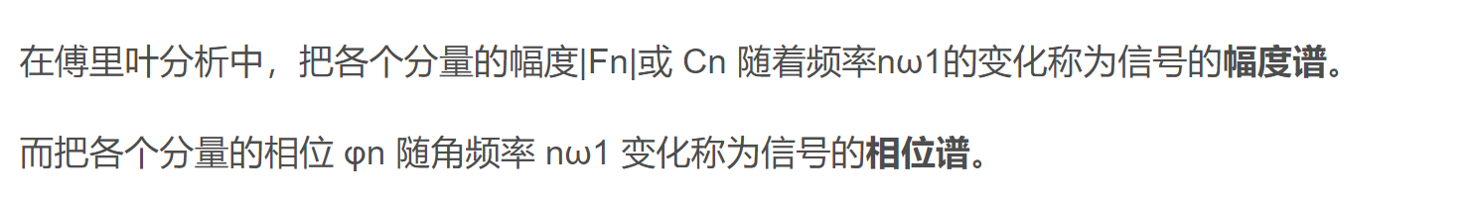




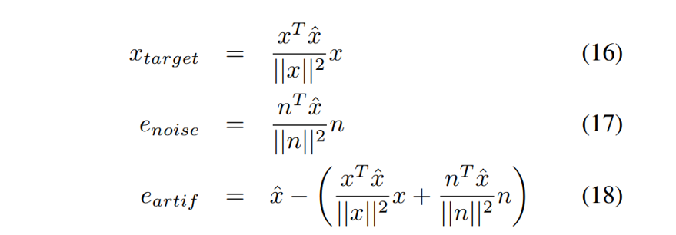
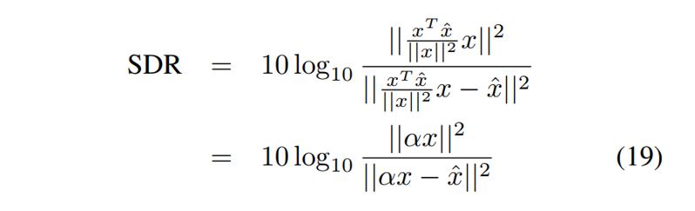
Transformer based speech enhancement
clean waveform
TGSA
STFT
Nosiy Amplitude
mask
pred Amplitude
*
nosiy waveform
I-STFT
pred waveform
红色：噪声
蓝色：语音
nosiy phase
clean waveform
loss = - SDR

Slide 4
目录
0. 语音分离中的mark → (语音分离总结.md)
语音增强中的mark → Transformer speech Enhancement
2. 对比学习 → CPC(Representation Learning with Contrastive Predictive Coding)
3. More idea

Slide 5
感谢聆听！

